Slide 1
Capstone Project University Ranking Analysis
Presented by Mohammad Sohel

Slide 2
Overview
The dataset provides a wealth of valuable information regarding universities across multiple countries, meticulously evaluated using three distinct ranking systems. Furthermore, it offers comprehensive details about the countries hosting these prestigious universities, including their representation, specific rankings, and the intricate assessment criteria applied.

Slide 3
THE PROCESS
Data Acquisition from GitHub
Obtain the necessary dataset from a specified GitHub repository.
Data Transformation and Enhancement
Perform data transformation processes to enhance data quality and maintain consistency.
Problems Statement Solution in Power BI
Utilize the capabilities of Power BI to address the given problem statements.
Exploratory Data Analysis (EDA)
Perform a thorough exploration of the data, utilizing either Excel or SQL Workbench based on the data's complexity.
Detailed Documentation
Compile a comprehensive report that thoroughly captures the entire project lifecycle

Slide 4
OBJECTIVE
Conduct a comprehensive analysis of university rankings dataset
Identify Patterns, Trends, and Influential Factors
Enhance Institutional Quality and Competitiveness.

Slide 5
KEY FINDINGS AND INSIGHTS
Corelation between factors and rankings.
Enhancing decision making in higher education.
FINDING impact of limitations and biases on rankings.

Slide 6
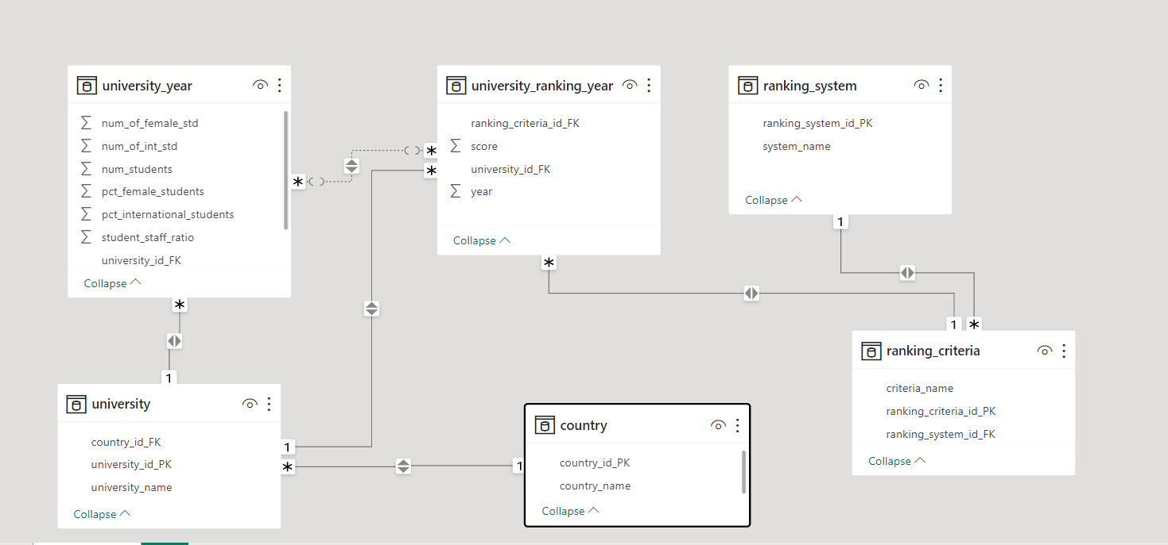
ER Diagram

Slide 7
Power bi problems and solution

Slide 8
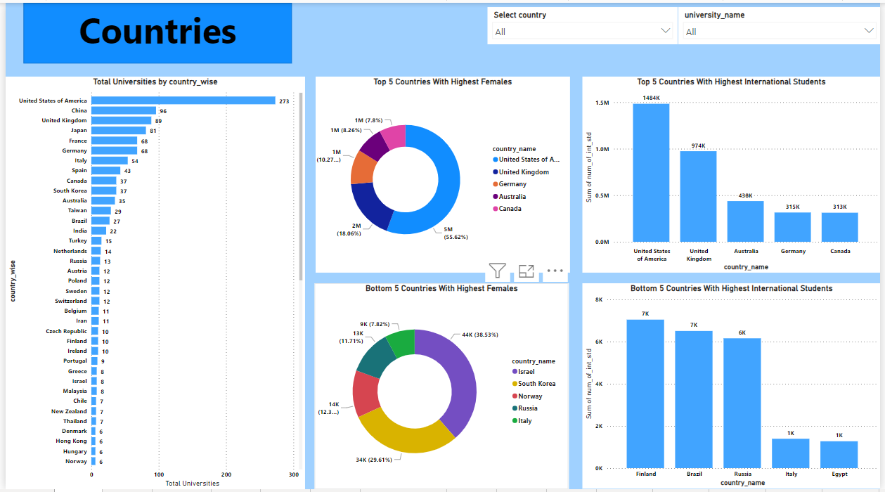

Slide 9
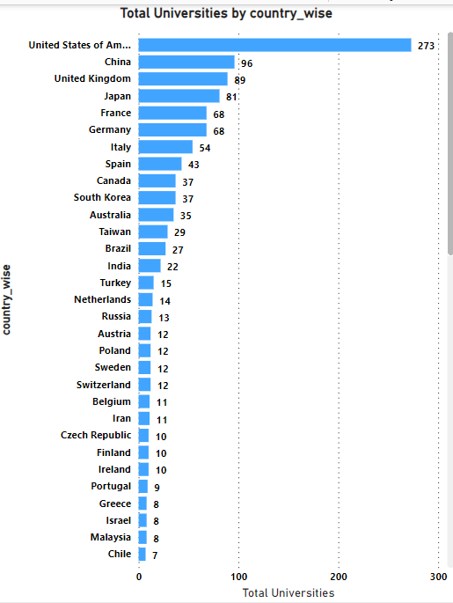
How many universities are there in each country?
Based on the chart, it is evident that the United States of America boasts the highest number of universities, with a total of 273.

Slide 10
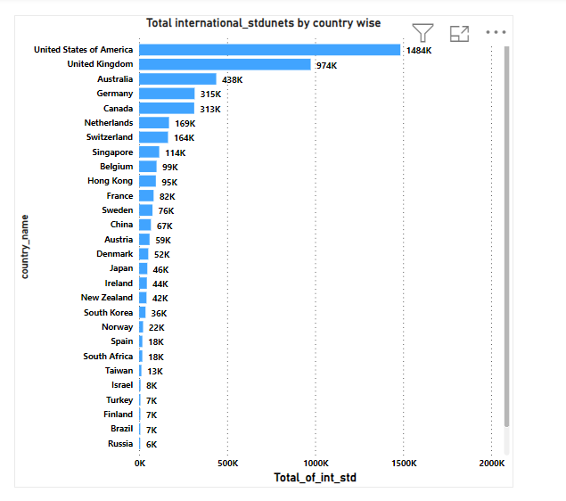
What is the distribution of international students across different countries?
By seeing this chart we can say the United States of America has the highest number of international students, with the United Kingdom taking second place.

Slide 11
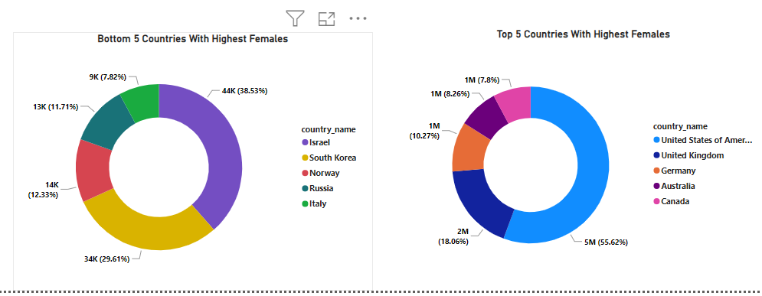
Which country has the highest number of female students enrolled in universities?
WE can see united state of America has highest number of female students nearly 5 million and Italy has the lowest number of female students around 9 thousand only.

Slide 12
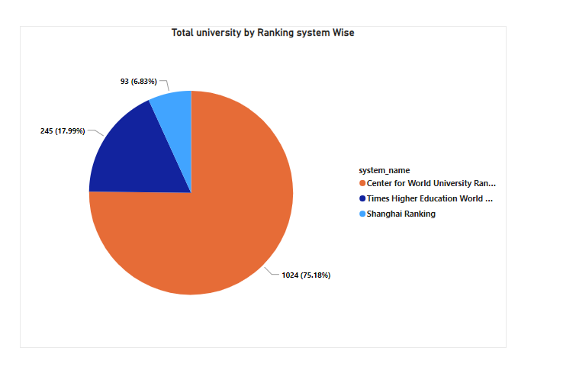
How many universities are ranked by each ranking system?
In the chart, we can observe that the Centre for World University Rankings has ranked the highest number of universities, while the Shanghai Rankings have ranked a smaller number.

Slide 13
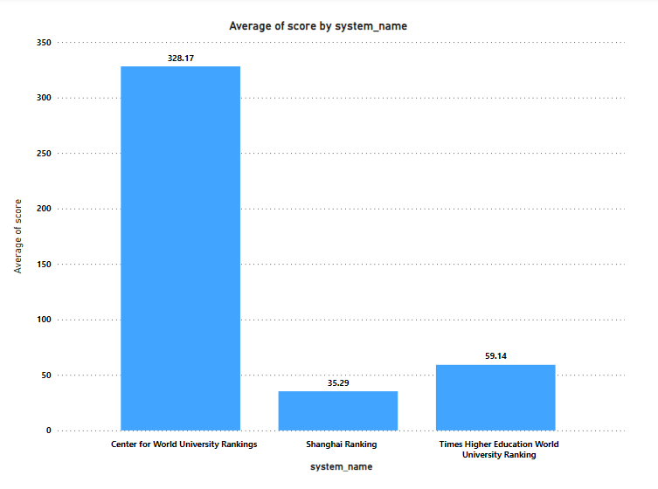
What is the average score for universities according to each ranking system?
We can observe from the chart that the Centre for World University Rankings has the highest average score, nearly 340, while the Shanghai Ranking has the lowest average score.

Slide 14
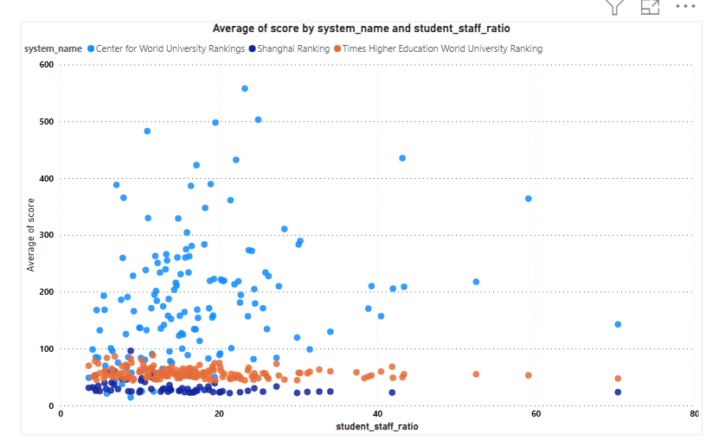
How does the ranking system affect a university's student-staff ratio?
The analysis reveals that many universities exhibit an average score below 200 coupled with a student-staff ratio around 40.

Slide 15
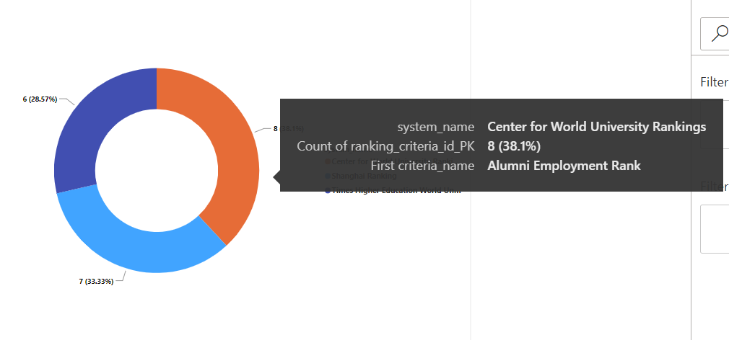
What are the most important criteria considered by ranking systems?
From the given visual we can understand Alumni Employment, Citations Ranks and Influence Rank are most crucial criteria for ranking system.

Slide 16
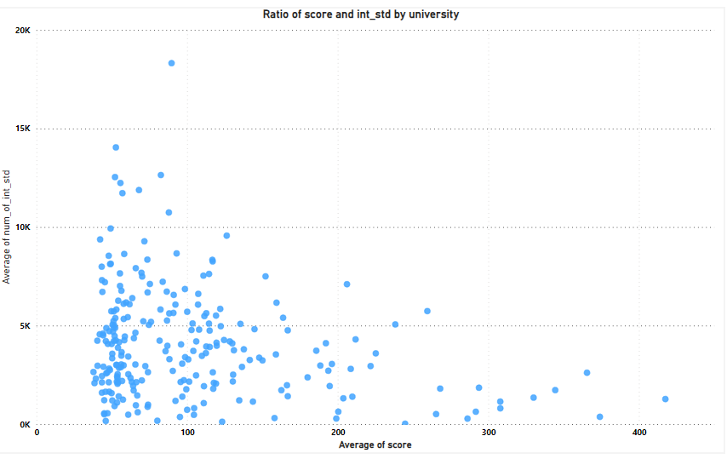
Is there a correlation between a university's score and the number of international students?
From the given visual, we can understand that many universities exhibit an average score below 100, coupled with international student populations around 10,000.

Slide 17
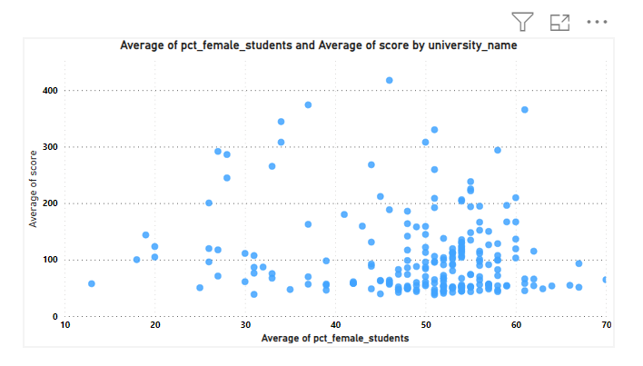
How does the percentage of female students impact a university's ranking?
From the given visual we can understand THERE IS NEGATIVE CORELATION BETWEEN female students AND university's ranking WHEN SCORE IS LESS THE PERCENTAGE OF FEMALE STUDENTS INCREASED.

Slide 18
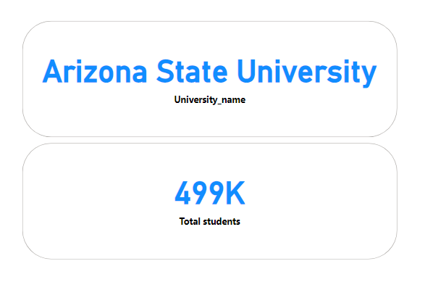
Which university has the highest number of students?
WE CAN SEE THAT ARIZONA STATE UNIVERSITY HAS NEARLY 500K STUDENTS.

Slide 19
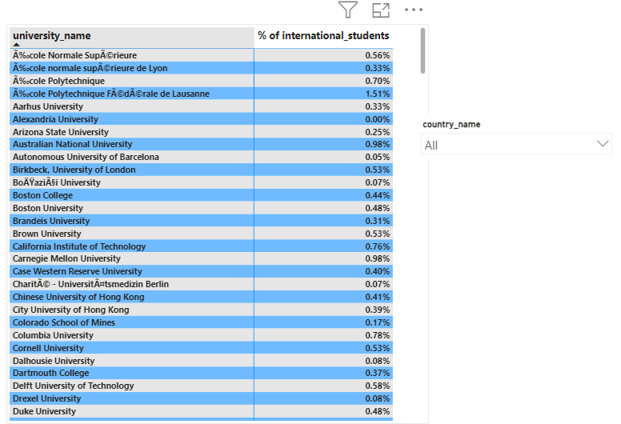
How does the percentage of international students vary across different universities?
we can SEE HOW INTERNATIONAL STUDENTS CHANGE ACROSS DIFFERENT UNIVERSITIES.

Slide 20
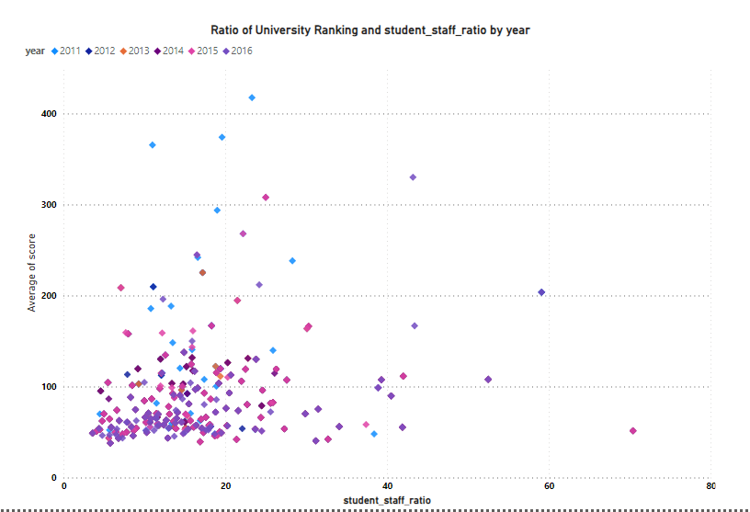
Is there a correlation between a university's ranking and its student-staff ratio?
The analysis reveals that IN YEAR 2015,2016 AND 2013 exhibit an average score below 200 coupled with a student-staff ratio around 20.

Slide 21
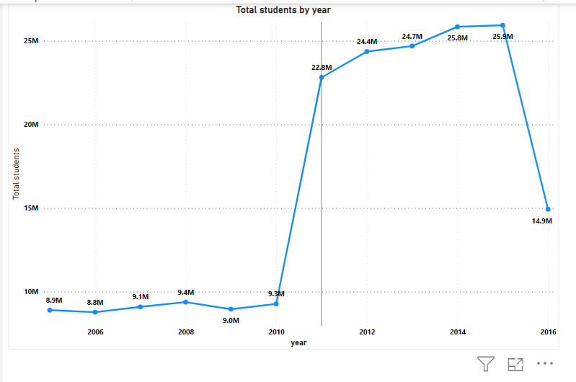
How does the number of students in universities change over time?
we can CLEARLY SEE THERE IS DROP IN NUMBER OF STUDENTS FROM YEAR 2015 TO 2016 AND SUDDENLY HIKE IN 2011.

Slide 22
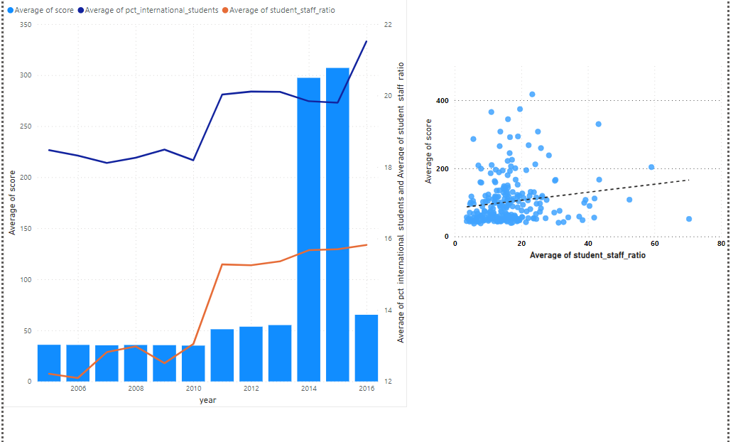
Is there a correlation between a university's ranking score and the student-staff ratio over the years?
We have created dual axis visual to show relationship of average score with average no of international students and average student staff ratio.

Slide 23
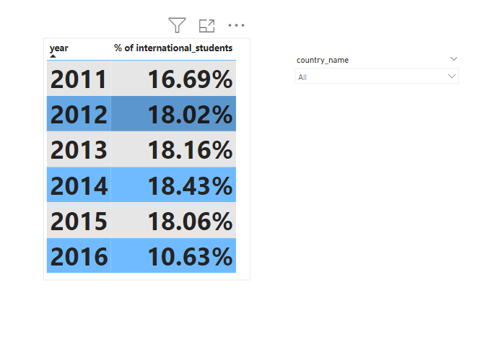
How does the percentage of international students vary across different years?
we can SEE HOW INTERNATIONAL STUDENTS CHANGE ACROSS DIFFERENT YEARS.

Slide 24
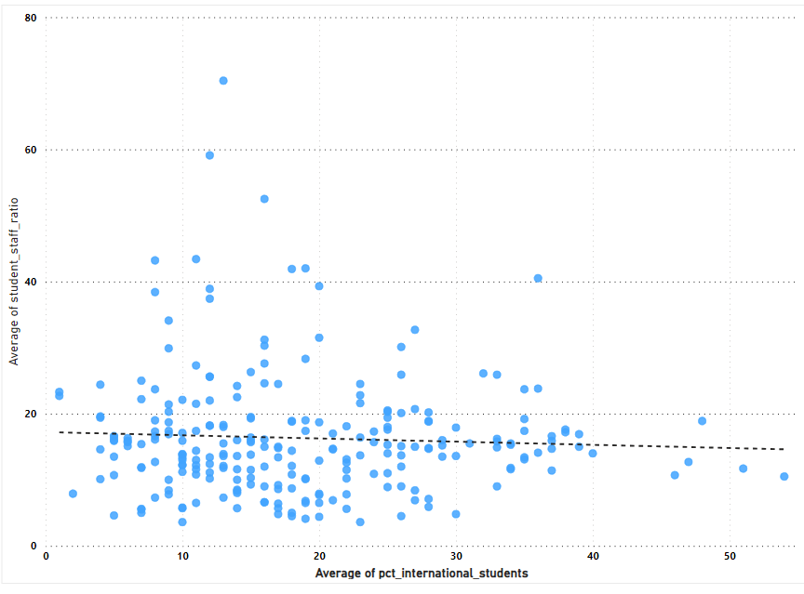
What is the impact of a university's ranking on the number of international students it attracts?
Ã‰cole Polytechnique FÃ©dÃ©rale de Lausanne had the highest average percentage of international students (54.00%), while the University of Bonn had the highest average student-to-staff ratio (70.40).

Slide 25
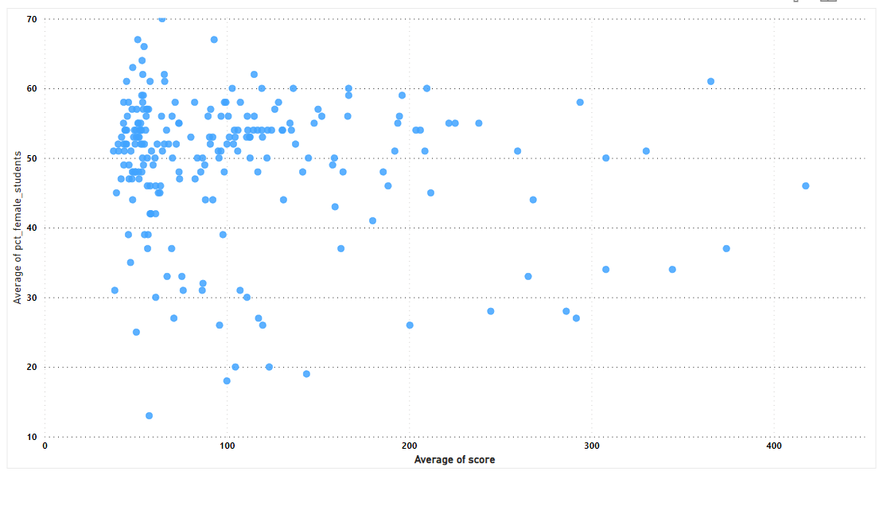
Is there a relationship between a university's ranking score and the percentage of female students enrolled?
From the given visual we can understand THERE IS NEGATIVE CORELATION BETWEEN female students AND university's ranking WHEN SCORE IS LESS THE PERCENTAGE OF FEMALE STUDENTS INCREASED.

Slide 26
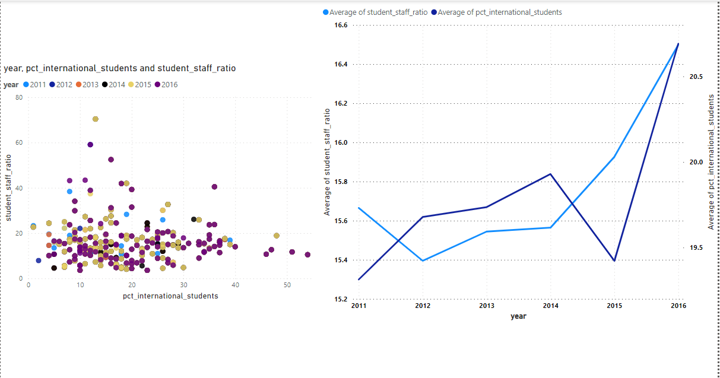
How does the percentage of international students affect a university's student-staff ratio?
The analysis reveals that THERE IS POSITIVE RELATIONSHIP BETWEEN.

Slide 27
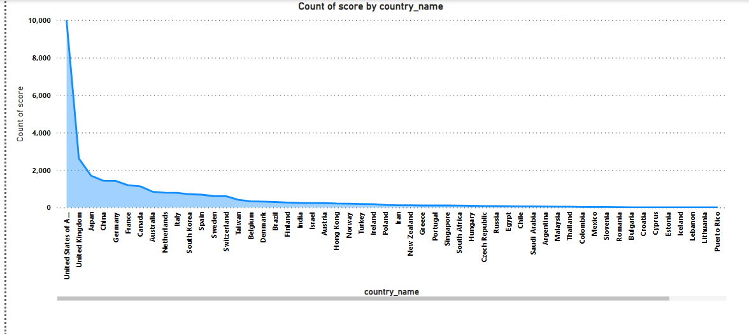
Are there any significant trends or patterns in the rankings of universities from different countries?
University rankings vary widely from one country to another, making it clear that there's no consistent pattern worldwide. The USA leads with the most ranked universities.

Slide 28
EDA
PROBLEM
STATEMENTS

Slide 29
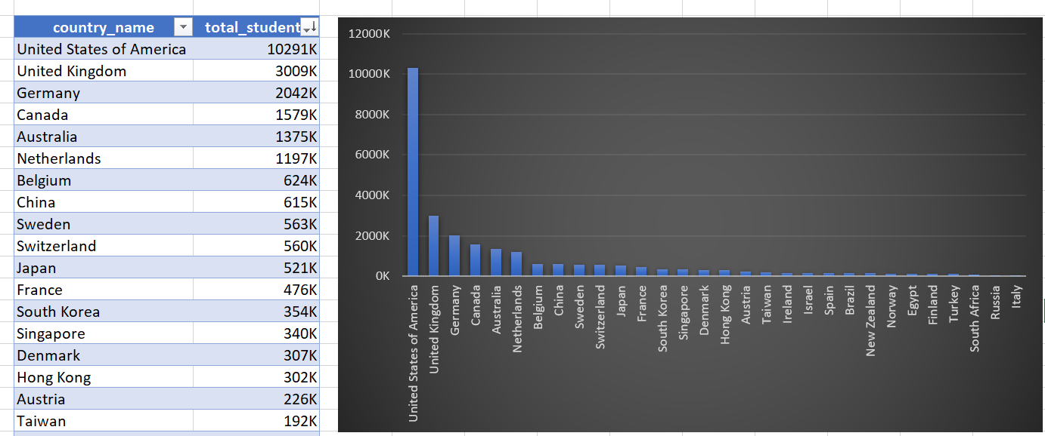
Calculate the country wise total Students?
WE CAN CLEARLY SEE UNITED STATE HAS MOST NUMBER OF STUDENTS.

Slide 30
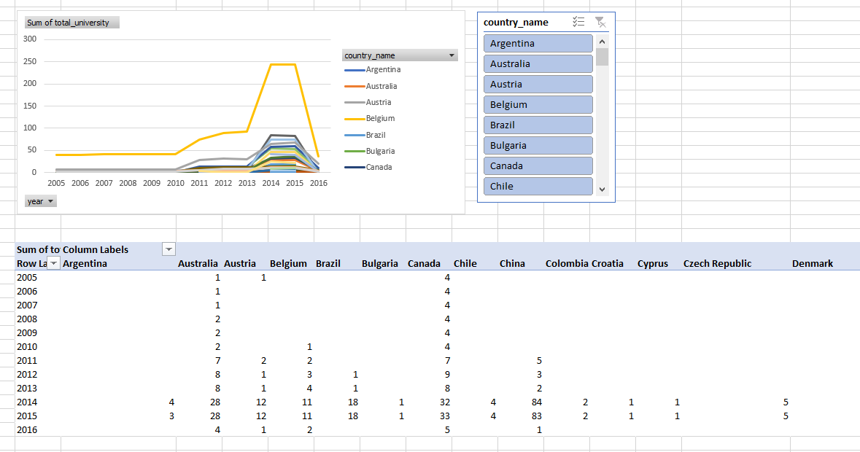
How has the number of universities changed over the years in each country?
WE CAN SEE CHANGES IN NUMBER OF UNIVERSITIES OVER THE YEARS.

Slide 31
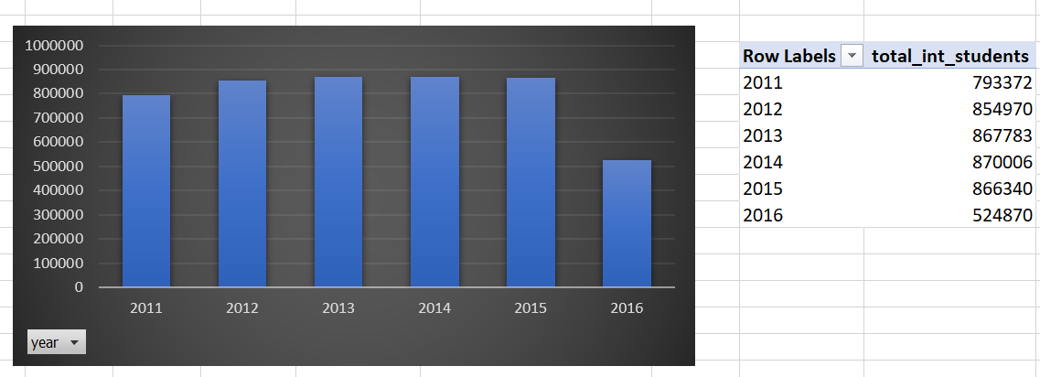
Analyze the Year wise International Students?
By analyzing we got between 2011 and 2014, the number of international students showed a steady upward trajectory, reaching a peak of 870,000 in 2014 AND In 2016, however, a sharp decline occurred.

Slide 32


Are there any common criteria used by different ranking systems?
By Analyzing we can see from the above output we can conclude that there are no such common criteria used by ranking system.

Slide 33
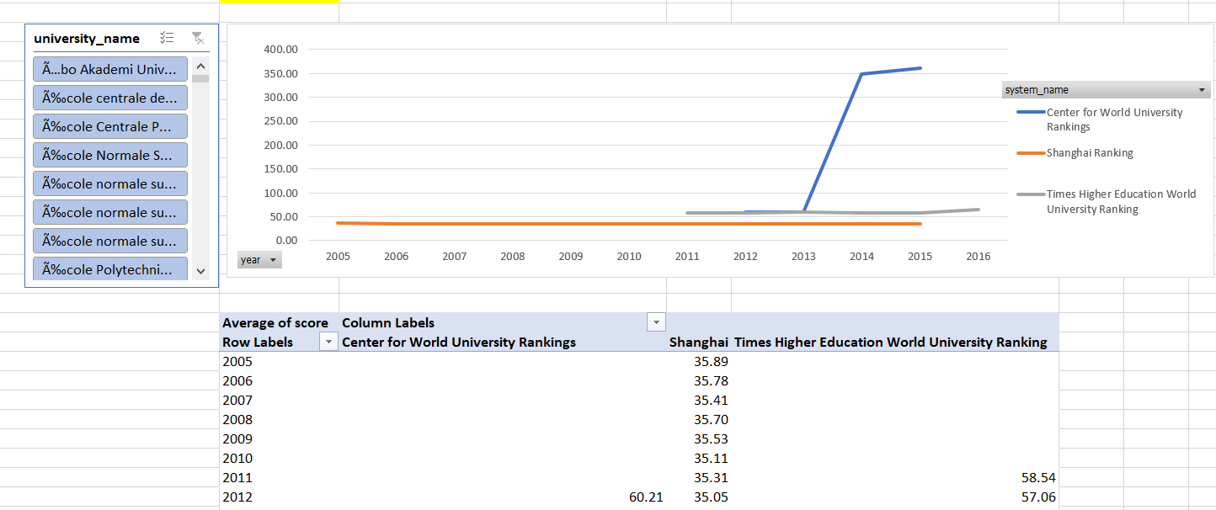
What is the trend in university rankings over the years according to each system?
The trends in university rankings over the years according to various ranking systems, the Shanghai Ranking, the insight notes less fluctuation AND the Center for World University Rankings saw a significant event in 2014.

Slide 34
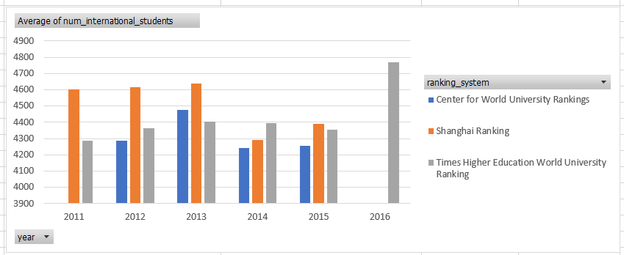
How does the choice of ranking system affect a university's international student enrollment?
The analysis reveals that FOR Times Higher Education World University Ranking AND SHANGAI RANKING GOT MOST NUMBER OF INTERNATINAL STUDENTS.

Slide 35
Are there any criteria that have different weights in different ranking systems
By Analyzing we can see from the above output we can conclude that there are no such common criteria used by ranking system.

Slide 36
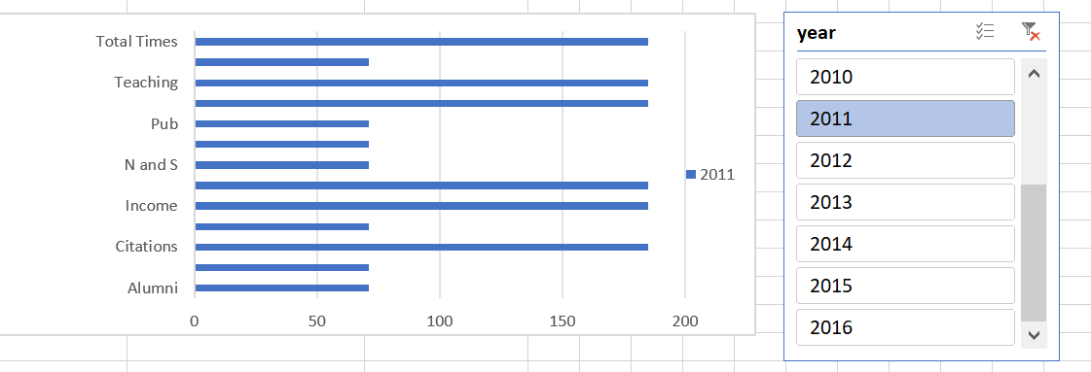
How have the weights of ranking criteria changed over time?
WE CAN SEE HOW WEIGHTS OF RANKING CRITERIA CHANGED OVER TIME.

Slide 37
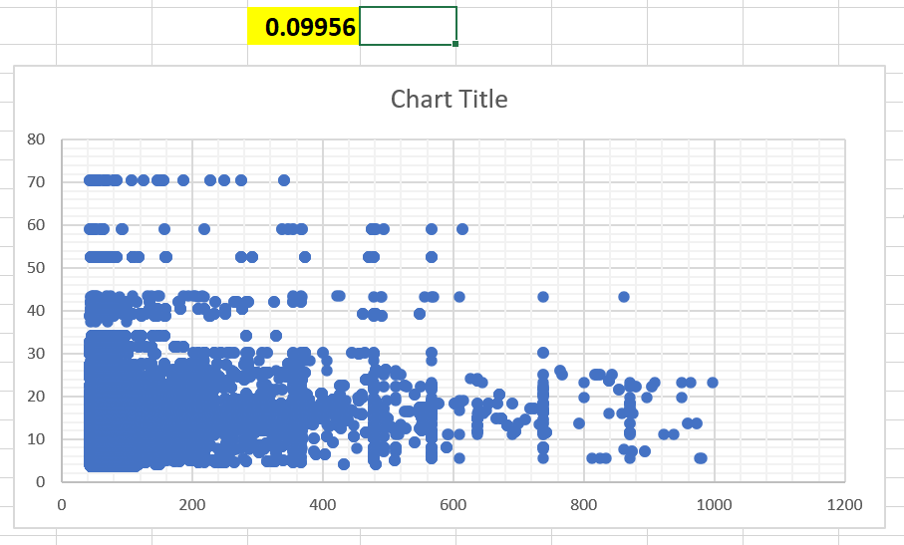
Is there a relationship between a university's score and the student-staff ratio?
WE CAN CLEARLY SEE THERE IS POSITIVE RELATION BETWEEN THEM.

Slide 38
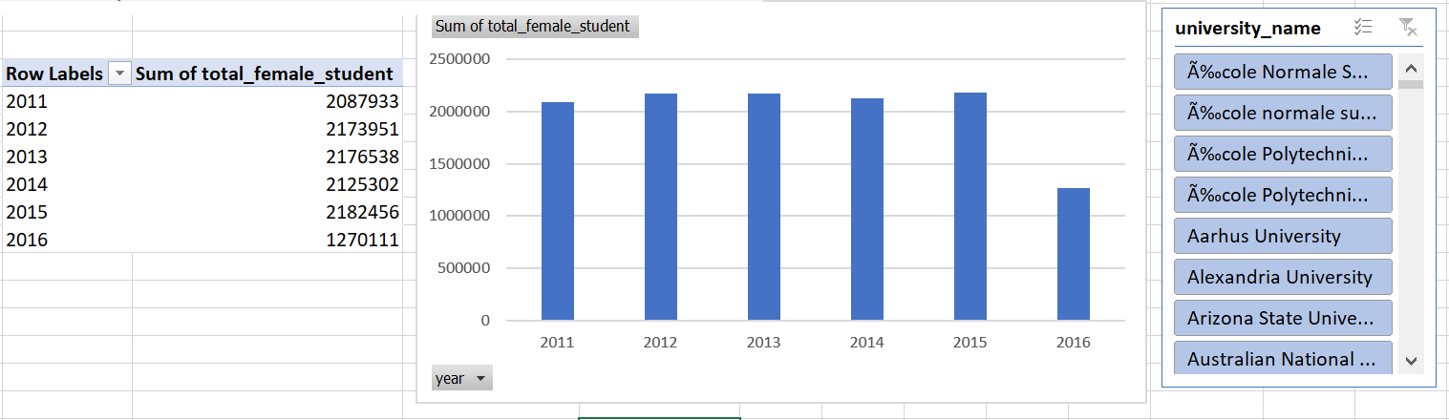
How does the number of female students different among universities?
By Analyzing we can see, The number of female students varies among universities. Some universities have a more balanced gender ratio, with a relatively equal number of male and female students.

Slide 39
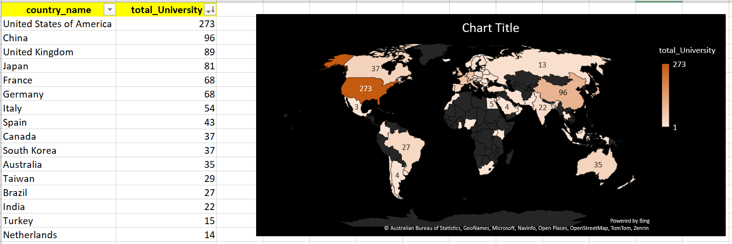
What is the distribution of universities across different countries?
By seeing this chart we can say the United States of America has the highest number of international students, with the United Kingdom taking second place.

Slide 40
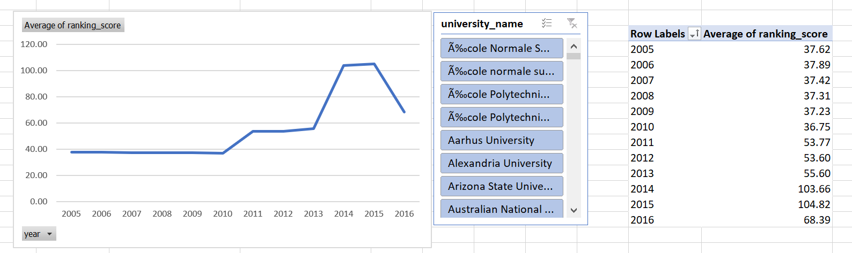
How has the ranking of universities changed over the years?
University rankings have shown stability from 2005 to 2011, with subsequent fluctuations in 2014 and 2016 indicating dynamic changes in academic quality and competition

Slide 41
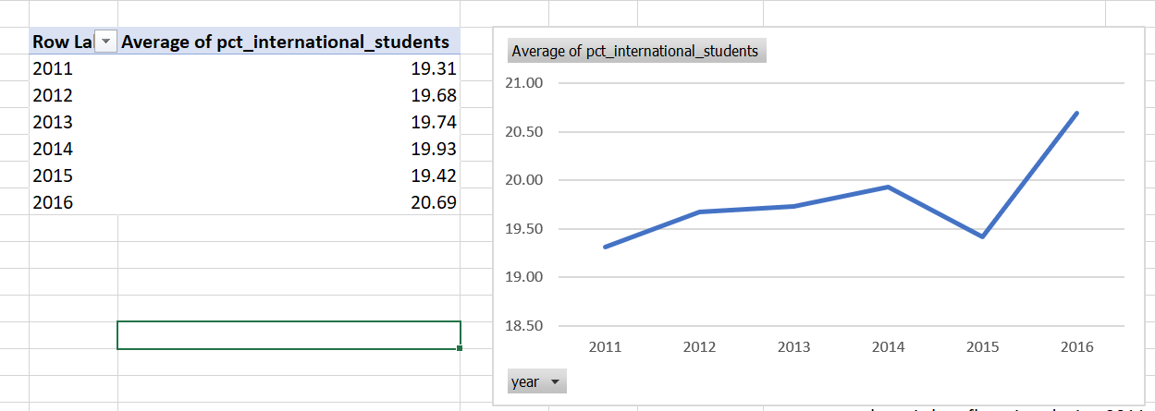
What is the trend in the percentage of female students over time?
The percentage of female students remained stable from 2011 to 2014 but experienced a sudden drop in 2015, followed by a significant increase in 2016, indicating a noteworthy shift in gender composition among students during this period.

Slide 42
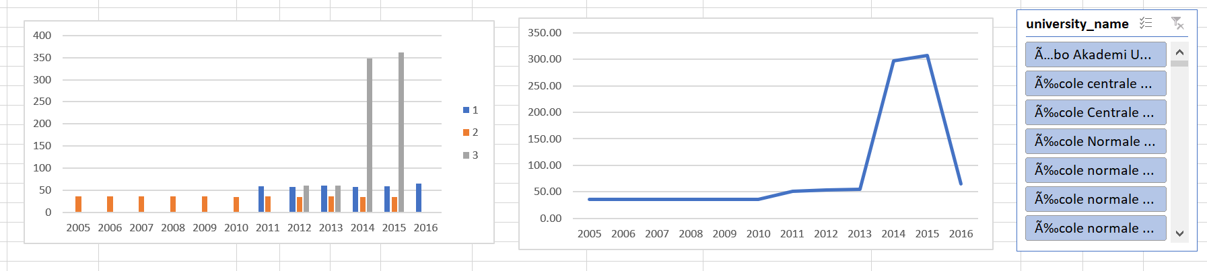
How has the ranking score of universities evolved over the years?
University ranking scores remained stable with gradual improvement from 2005 to 2013, followed by a remarkable surge in 2014 and a sharp drop in 2016, reflecting significant performance fluctuations likely influenced by various factors.

Slide 43
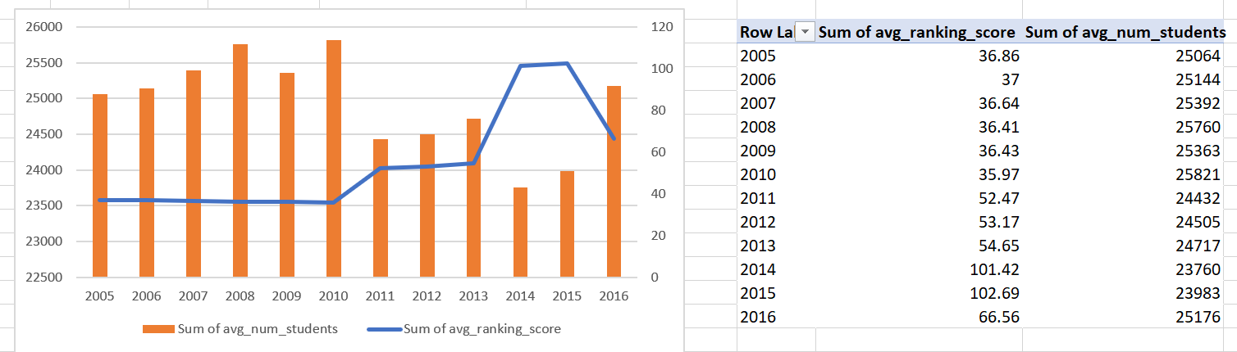
Is there a relationship between a university's ranking score and the number of students over time?
Analyzing the data reveals a negative correlation between average ranking scores and student numbers, with significant variations in 2011 and 2012.

Slide 44
CONCLUSION
In this project, we found that research quality significantly influences university rankings, with high-ranking universities consistently producing impactful publications. However, student-to-staff ratios and a country's population do not exhibit a strong correlation with ranking, and rankings can be influenced by the organization's location, potentially introducing bias.

Slide 45
THANK YOU
MOHAMMAD SOHEL

